Slide 1
Parents
Helping Your Student Succeed Financially in College

Slide 2
After this workshop, you will be able to share with your student:
Ways to recognize and prevent identity theft
Crucial differences between debit cards and credit cards
Actions that impact credit scores
Reasons for establishing a banking relationship
Options for paying for college
Strategies on living within your means

Slide 3
Identity Theft
Identity theft occurs when someone uses your personal identification information—such as your name, Social Security number, or credit card number—without your permission to commit fraud or other crimes.

Slide 4
How Does it Happen?
Stolen mail
Stolen wallet
Dumpster diving
Pre-texting
Phishing
Skimming
Social networking websites

Slide 5
Thieves Among Friends
Roommates
Repair workers
Landlords
Family members
Coworkers
Former significant others

Slide 6
Ways to Deter Thieves
Never leave wallet, purse, or backpack lying around
Shred, shred, shred paperwork
Protect your Social Security number at all times
Verify a source before sharing personal information
Never click on links embedded in unsolicited emails
Don’t use an obvious password or PIN
Keep your personal information secure

Slide 7
Ways to Detect Identity Theft
Mail or bills don’t arrive as expected
Unexpected credit card statements
Denials of credit for no apparent reason
Calls or letters about purchases you didn't make
Items on credit report that aren’t yours
Items on bank statements or credit card statements that don’t belong

Slide 8
How to Recover
The Federal Trade Commission (FTC) recommends these four steps:
Place a fraud alert on credit reports
Close bank and retail accounts
File a complaint with the FTC
File a police report
www.Identitytheft.gov

Slide 9
Debit vs. Credit
Debit Cards
It’s your money
Item cost = actual cost
Liability limited to $50 if reported within two days; three to 60 days, $500
Some retailers “block” your card
May cause overdraft fees to be assessed if you opt in
Can be used for online/phone purchases
Credit Cards
It’s the bank’s money
Item cost = or > actual cost
Liability limited to $50
May extend warranties
Fee charged for late payments
Fee charged for over the limit if you opt in
Can be used for online and phone purchases

Slide 10
CARD Act of 2009
Disclosures
Minimum monthly payment
36-month payoff payment
Evaluation of ability to pay
Consumer must have income or assets
Consumers under the age of 21 without ability to pay must have a co‐signer with ability to pay

Slide 11
Unintended Consequences
Students ask fellow students who are over 21 to act as a co-signer.
“They are permanently joined by the wallet with the liability.”
—John Ulzheimer, President of Consumer Education, SmartCredit.com

Slide 12
How Much is Too Much?
30% of undergraduates have a credit card, down from 42% in 2010
The median balance has fallen to only $136
62% of students with credit cards pay off the balance of all cards each month; another 33% pay at least the minimum required payment.
*Source: “How America Pays for College 2013,” Sallie Mae

Slide 13
Tips for Staying Out of Credit Card Debt
Limit yourself to one low interest (APR) card.
Charge only what you can afford to pay off each month.
Pay your bill on time.
Actively manage your account to avoid fraud.
Use this credit card calculator BEFORE you charge.

Slide 14
What Goes into a Credit Score?
On-time payments: 35%
Capacity Used: 30%
Length of History: 15%
New Credit: 10%
Types of Credit: 10%

Slide 15
Ways to Protect Your Credit
Pay all bills ON TIME
Do NOT max out your credit cards
Do NOT open credit card accounts at retail stores just to get an initial discount
Do NOT co-sign for a friend
Check receipts against charges
Do NOT bounce checks
CashCourse Articles: Topics → Borrow → Credit Scores & Reports

Slide 16
Who Needs a Bank?
Convenience
Cost-effective
Safety
Easier budgeting
Proof of payment

Slide 17
What to Look for in a Bank
Access to branches or ATMs
Minimum balance requirements
ATM/debit card options
Monthly activity requirements
Online bill pay option
CashCourse Article: Topics → Save & Invest → Banking

Slide 18
Fees
Account fee
Online banking fee
Minimum balance fee
Bounced check fee
Overdraft fee
ATM card fee
ATM transaction fee for ATMs not owned by your bank

Slide 19
Paying for College
College can be expensive, but it’s worth the investment!
Tips to ease the pain:
Scholarships aren’t just for freshman year.
Federal loans offer better rates than private loans or credit cards.
Only borrow what you really need.

Slide 20
What Happens if You Default
Up to 100+ point drop in credit score
Ineligible for additional federal student aid
Wages garnished
State and federal tax refunds withheld
Late fees and collection costs added to loan
Potential lawsuit

Slide 21
Repaying Student Loans
There are seven repayment plans available:
Standard
Extended
Graduated
Income Based Repayment
Pay As You Earn
Income Contingent (Direct Loan program only)
Income Sensitive Repayment Plan

Slide 22
Spending Wisely
Create a budget
Stick with the meal plan
Avoid money traps (rent-to-own, pawn shops, check-cashing outlets)
Go to free on-campus events
Use your student discount card
Limit downloads of music, apps, etc.

Slide 23
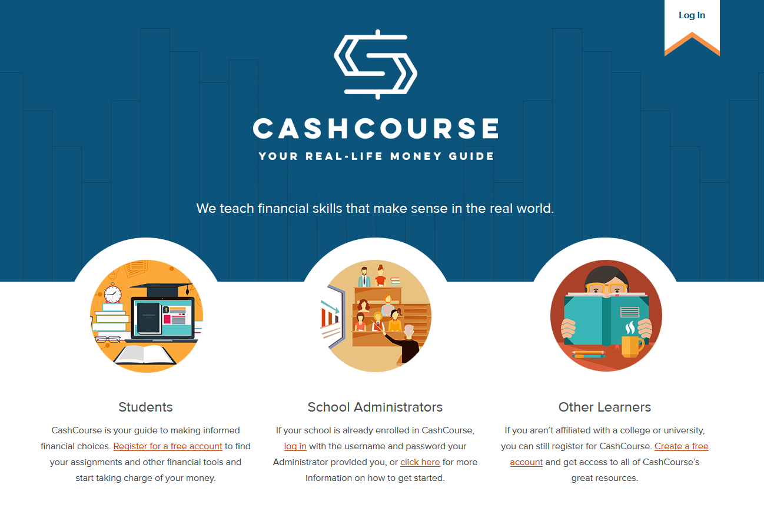
Who Will Be There When I Go Home?

Slide 24
What is CashCourse?
CashCourse is a FREE website that provides students with personal finance information for every stage of college life.
All content is unbiased and commercial free. There is no advertising and no commercial products represented.
Brought to your college and the National Endowment for Financial Education.

Slide 25
CashCourse Article Topics
Earn
Save & Invest
Protect
Spend
Borrow
Pay for Education

Slide 26
…And Financial Tools
Budget Wizard
Financial Calculators
Worksheets
Quizzes
Dictionary of Financial Terms
Financial Experts Wall

Slide 27
We Are Here to Help: Resources on Campus

Slide 28
Recap
Managing money now means a better future for your student.
CashCourse provides access to a wealth of information.
Students can access important services on campus.

Slide 29
Next Steps
Show your student CashCourse online.
Share your Money Management Checklist with your student.
Share your Words of Wisdom with your student.
Maintain an open dialogue about money management.
Take a deep breath—you and your student will be fine!

Slide 30
Thanks for Attending our Workshop!
These materials are for noncommercial educational use only.
Portions of the content © 2017 National Endowment for Financial Education®. All rights reserved.
CashCourse® is a trademark of the National Endowment for Financial Education. www.nefe.org. www.cashcourse.org

